Slide 1
Biomedical (cancer) text document classification
Presented By: Dnyaneshwar Ainar

Slide 2
Problem statement
The goal of this project is to create an accurate, generalizable, and scalable text categorization Machine learning Model based on NLP in order to simplify the present information extraction process..

Slide 3
What is text classification?
Text classification is an analytical process that takes any text document as input and assigns a label (or classification) from a predetermined set of class labels.
Text classification can automatically analyze text and assign it to one of a number of predefined tags or categories based on its content. These unstructured narrative texts are written by the doctors, nurses, pharmacists, and staff who provide care to a patient.
Therefore, the goal of this project is to create an accurate and scalable text categorization tool based on NLP in order to simplify the present information extraction process..

Slide 4
Why is Text Classification Important?
Text is one of the most common types of unstructured data and It’s estimated that around 80% of all information is unstructured. Because text is messy, analyzing, understanding, organizing, and sorting through text data is difficult and time-consuming, so most businesses do not use it to its full potential.
This is where machine learning for text classification comes in. Companies can use text classifiers to automatically structure all types of relevant text, including emails, social media, chatbots, surveys, and more, in a quick and cost-effective manner. Companies can save time analyzing text data, automate business processes, and make data-driven business decisions as a result of this.

Slide 5
About 30% of the global data are generated related to healthcare. A large portion of this data is made up of electronic health records (EHRs), which are an essential component of the hospital information system.
Clinical records are a type of electronic health record data that contains detailed and valuable patient information as well as doctor’s clinical experience. As a result, text classification is an important task in clinical record retrieval and organisation; it can also help in clinical decision making.
Classifying large amounts of textual data aids in platform standardization, makes search easier and more relevant, and improves user experience by simplifying tracking. Unusually, machine learning and deep learning are also constructing roots in previously unseen and conventional areas.

Slide 6
Why use machine learning for text classification? Some of the top reasons:
Scalability:
Manually analyzing and organizing text data is slow and less accurate.. Machine learning can automatically analyze millions of comments, emails, etc., at a fraction of the cost, often in just a few minutes.
Analysis in real time:
There are critical situations that businesses must identify as soon as possible and act on. Machine learning text classification can track your brand mentions in real time, allowing you to identify critical information and act quickly.

Slide 7
Consistency :
Because of distractions, fatigue, and boredom, human creators make mistakes when classifying text data, and human subjectivity creates inconsistent criteria. Machine learning, on the other hand, looks at all data and results through the same lens and criteria. Once properly trained, a text classification model performs with best accuracy.

Slide 8
How do we achieve text classification in healthcare?
Text can be a very rich source of information, but due to its unstructured nature, extracting insights from it can be difficult and time-consuming. However, advances in natural language processing and machine learning, both of which fall under the broad umbrella of artificial intelligence, are making it easier to sort text data.
Type of text classification methods : rule-based methods and machine learning methods:
Rule-based text classification methods operate through the use of explicitly engineered linguistic rules. The system uses the rules created by the engineer to determine which class a given piece of text should belong to, looking for clues in the form of semantically relevant text elements. Every rule has a pattern that the text must match to be placed into the corresponding category.

Slide 9
Machine Learning Systems
Machine learning-based classification systems operate by applying algorithms that analyze datasets for patterns that are associated with a particular class.
The machine learning classifier analyzes the training data and learns patterns that are associated with the different classes. After this, unseen instances are stripped of their labels and fed to the classification algorithm which assigns the instances a label. The assigned labels are then compared to the original labels to see how accurate the machine learning classifier was.

Slide 10
Open-source libraries for text classification
Scikit-learn is a popular library for general-purpose machine learning. It supports a wide range of algorithms and offers simple and effective features for working with text classification, regression, and clustering models.
NLTK is a popular library focused on natural language processing (NLP) that has a big community behind it. It's super handy for text classification because it provides all kinds of useful tools for making a machine understand text, such as splitting paragraphs into sentences, splitting up words, and recognizing the part of speech of those words.

Slide 11
General Information..
According to Indian Council of Medical Research (ICMR),
Cancer deaths have been steadily increasing in the country, rising from 7.33 lakh annually in 2018 to 7.70 lakh two years later in 2020, the Centre told the Rajya Sabha on 24th July 2022.
In 2018, the number of deaths stood at 7,33,139, while in 2019, it went up to 7,51,517 and in 2020, the country reported 7,70,230 cancer deaths, said Minister of State for Health and Family Welfare Dr Bharati Pravin Pawar.

Slide 12
In another written reply, she said the estimated incidence of cancer cases in India (2018-2020) in both sexes went up, she said. While in 2018, an estimated 13,25,232 cancer cases were reported, it went up to 13,58,415 the following year. In 2020, 13,92,179 cancer cases were reported in the country.

Slide 13
Approach
Below mention are the steps involved in the completion of this project :
Data collecting
Data cleaning
EDA
Text Preprocessing
Feature Extraction
Model Building
Model Evaluation.

Slide 14
Data collection
Dataset is downloaded from Kaggle.com. ( Kaggle is an online community platform for data scientists and machine learning enthusiasts. Kaggle allows users to collaborate with other users, find and publish datasets, use GPU integrated notebooks, and connect with other data scientists to solve data science challenges. )
About Dataset :
The Dataset I am using for text classification includes cancer documents to be classified into 3 categories like 'Thyroid Cancer', 'Colon Cancer', 'Lung Cancer'. Total no. publications (row) = 7569. number of samples in each categories: colon cancer = 2579, lung cancer = 2180, thyroid cancer = 2810.

Slide 15
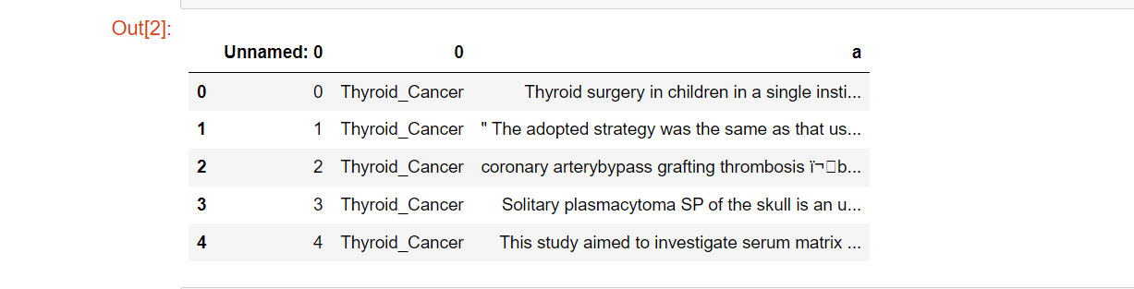
Viewing top five rows of dataset.

Slide 16
Data cleaning
Dataset not contain any null and duplicate value.
Dropping unnecessary column “Unnamed: 0 ”.
Renaming the column names:
Column ‘0’ contain target variable like; Thyroid Cancer, Colon Cancer, Lung Cancer thus renaming as ‘Target’.
Column ‘a’ contain clinical report text relation to target variable thus renaming as ‘Text’.

Slide 17
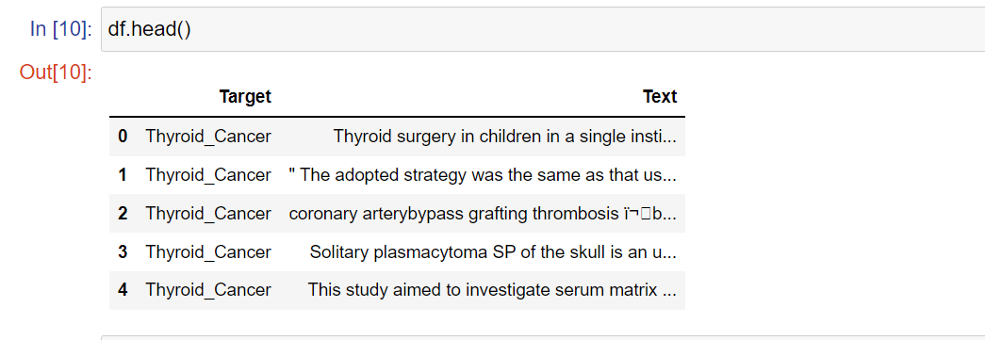
After cleaning Dataset, Reviewing data;

Slide 18
eda
Exploratory Data Analysis (EDA) is an approach to analyze the data using visual techniques. It is used to discover trends, patterns, or to check assumptions with the help of statistical summary and graphical representations.
Visualizing Target variable distribution using pie chart:
A Pie Chart is a type of graph that displays data in a circular graph. The pieces of the graph are proportional to the fraction of the whole in each category. In other words, each slice of the pie is relative to the size of that category in the group as a whole.

Slide 19
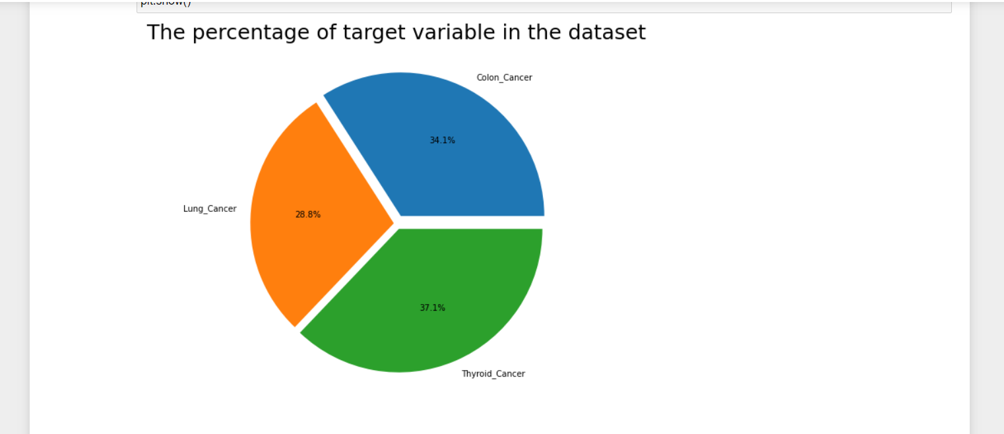
Visualizing Target variable distribution using pie chart

Slide 20
Visualizing text using word cloud
Word Cloud is a data visualization technique used for representing text data in which the size of each word indicates its frequency or importance.
It shows the popularity of words or phrases by making the most frequently used words appear larger or bolder compared with the other words around them.

Slide 21
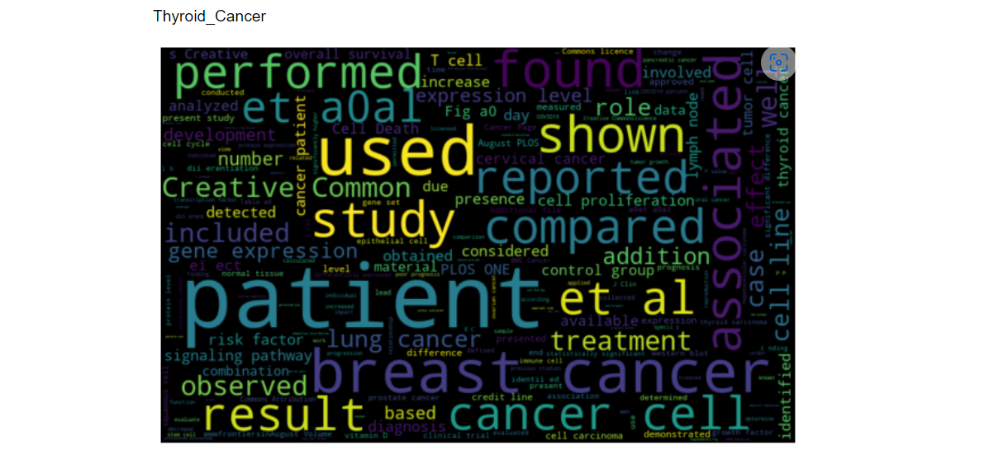
creating word cloud for thyroid cancer report
Thyroid cancer clinical report have following frequently occurred words.

Slide 22
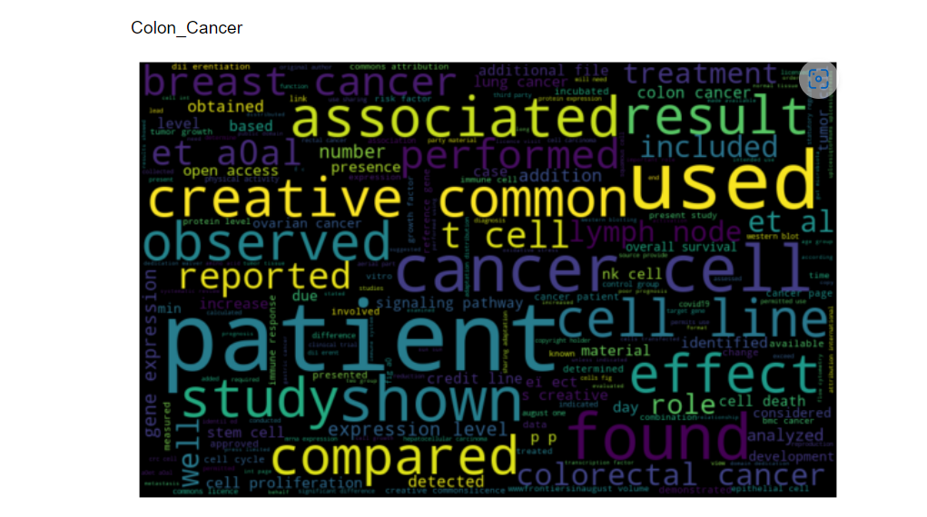
creating word cloud for colon cancer report
Colon cancer clinical report have following frequently occurred words.

Slide 23
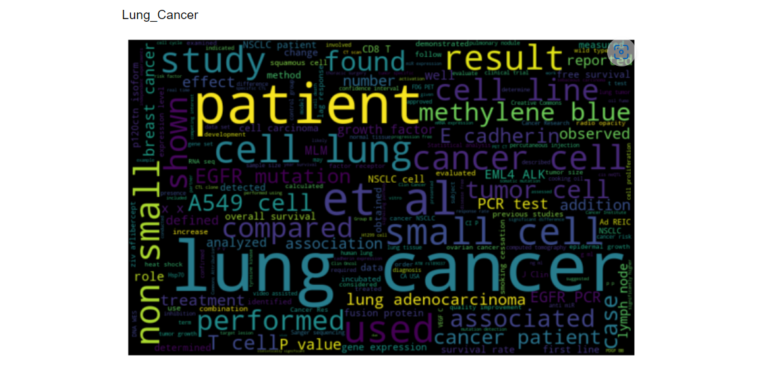
creating word cloud for lung cancer report
Lung cancer clinical report have following frequently occurred words.

Slide 24
Text Data Pre-processing
Since raw text data may contain unwanted or unimportant text, our results may be inaccurate and difficult to understand and analyze. As a result, proper pre-processing of raw data is required.
Natural Language Processing :
NLP is a field in machine learning with the ability of a computer to understand, analyze, manipulate, and potentially generate human language.
In other words;
Natural Language Processing (NLP) is a branch of artificial intelligence concerned with the interaction of computers and humans through the use of natural language. The ultimate goal of NLP is to read, interpret, understand, and make sense of human languages in a comfortable manner.

Slide 25
The Natural Language Toolkit, or NLTK , is a collection of libraries and programs written in Python for symbolic and statistical natural language processing in English.
Cleaning (or pre-processing) the Text data typically consists of a number of steps:
Remove punctuation
Tokenization
Remove stop-words
Lemmatize/Stemming

Slide 26
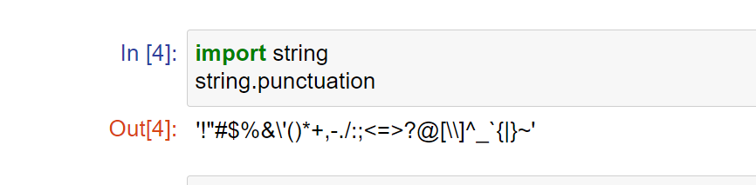
Remove punctuation :
The removal of punctuation marks, which are used to divide text into sentences, paragraphs, and phrases, is an important NLP preprocessing step because it affects the results of any text processing approach, particularly those that depend on the occurrence of frequencies of words and phrases.

Slide 27
Tokenization:
Tokenization is the process of converting a string or text into a list of tokens. Tokens can be considered of as parts in the same way that a word is a token in a sentence and a sentence is a token in a paragraph.
Or in simple way:
Tokenization is the process of breaking down a text or set of texts into individual words.

Slide 28
Remove stop-words :
Stop words are a group of words that are commonly used in any language. for example, "the“, "is," , "and“, 'i’, 'me', 'my', 'myself', 'we', 'our’…etc.
This is a important task to remove such words that doesn't make any meaning and allows processes to focus on the important words rather than meaningless stop-words.

Slide 29
Lemmatize/Stemming:
Stemming:
A single word in the English language has numerous variations. These differences introduce confusion into machine learning training and prediction. To build a successful model, such words must be filtered and converted to the same type of sequenced data using stemming.
Stemming is a type of word normalization. It is a technique in which a group of words in a sentence are converted into a sequence in order to shorten the lookup time. Normalized words are those that have the same meaning but differ slightly depending on the sentence. Stemming is thus a method of determining the root word from word variations.
Example: running→ run, runs→ run, fairly→ fair…etc.

Slide 30
Lemmatization:
Lemmatization is the algorithmic process of determining a word's lemma based on its meaning. Lemmatization is commonly used to describe the morphological analysis of words with the goal of removing inflectional endings. It aids in returning a word's base or dictionary form, known as the lemma.
Example: studies→ study, cries→ cry, tries→ try…etc.

Slide 31
Feature extraction
Text feature extraction is essential to text classification since it directly affects accuracy of text classification. Feature Extraction is transforming textual data into numerical data.
TF-IDF:
TF-IDF which stands for Term Frequency – Inverse Document Frequency. It is one of the most important techniques used for information retrieval to represent how important a specific word or phrase is to a given document.

Slide 32
TF-IDF use two statistical methods, first is Term Frequency(TF) and the other is Inverse Document Frequency(TDF).
Term frequency refers to the total number of times a given term (word) appears in the document doc against the total number of all words in the document .
The inverse document frequency measure of how much information the word provides. It measures the weight of a given word in the entire document.

Slide 33
Model building
It is a supervise learning problem because the current dataset has labelled data.
There are two types of supervised machine learning algorithm called classification and regression. This dataset comes under classification problem because the Dependent / Target variable is categorical and we want a class of predictable results.
The Machine learning algorithm for classification problem are:
Logistic Regression
Random forest
XGBoost
Naive bayes
SVM
KNN

Slide 34
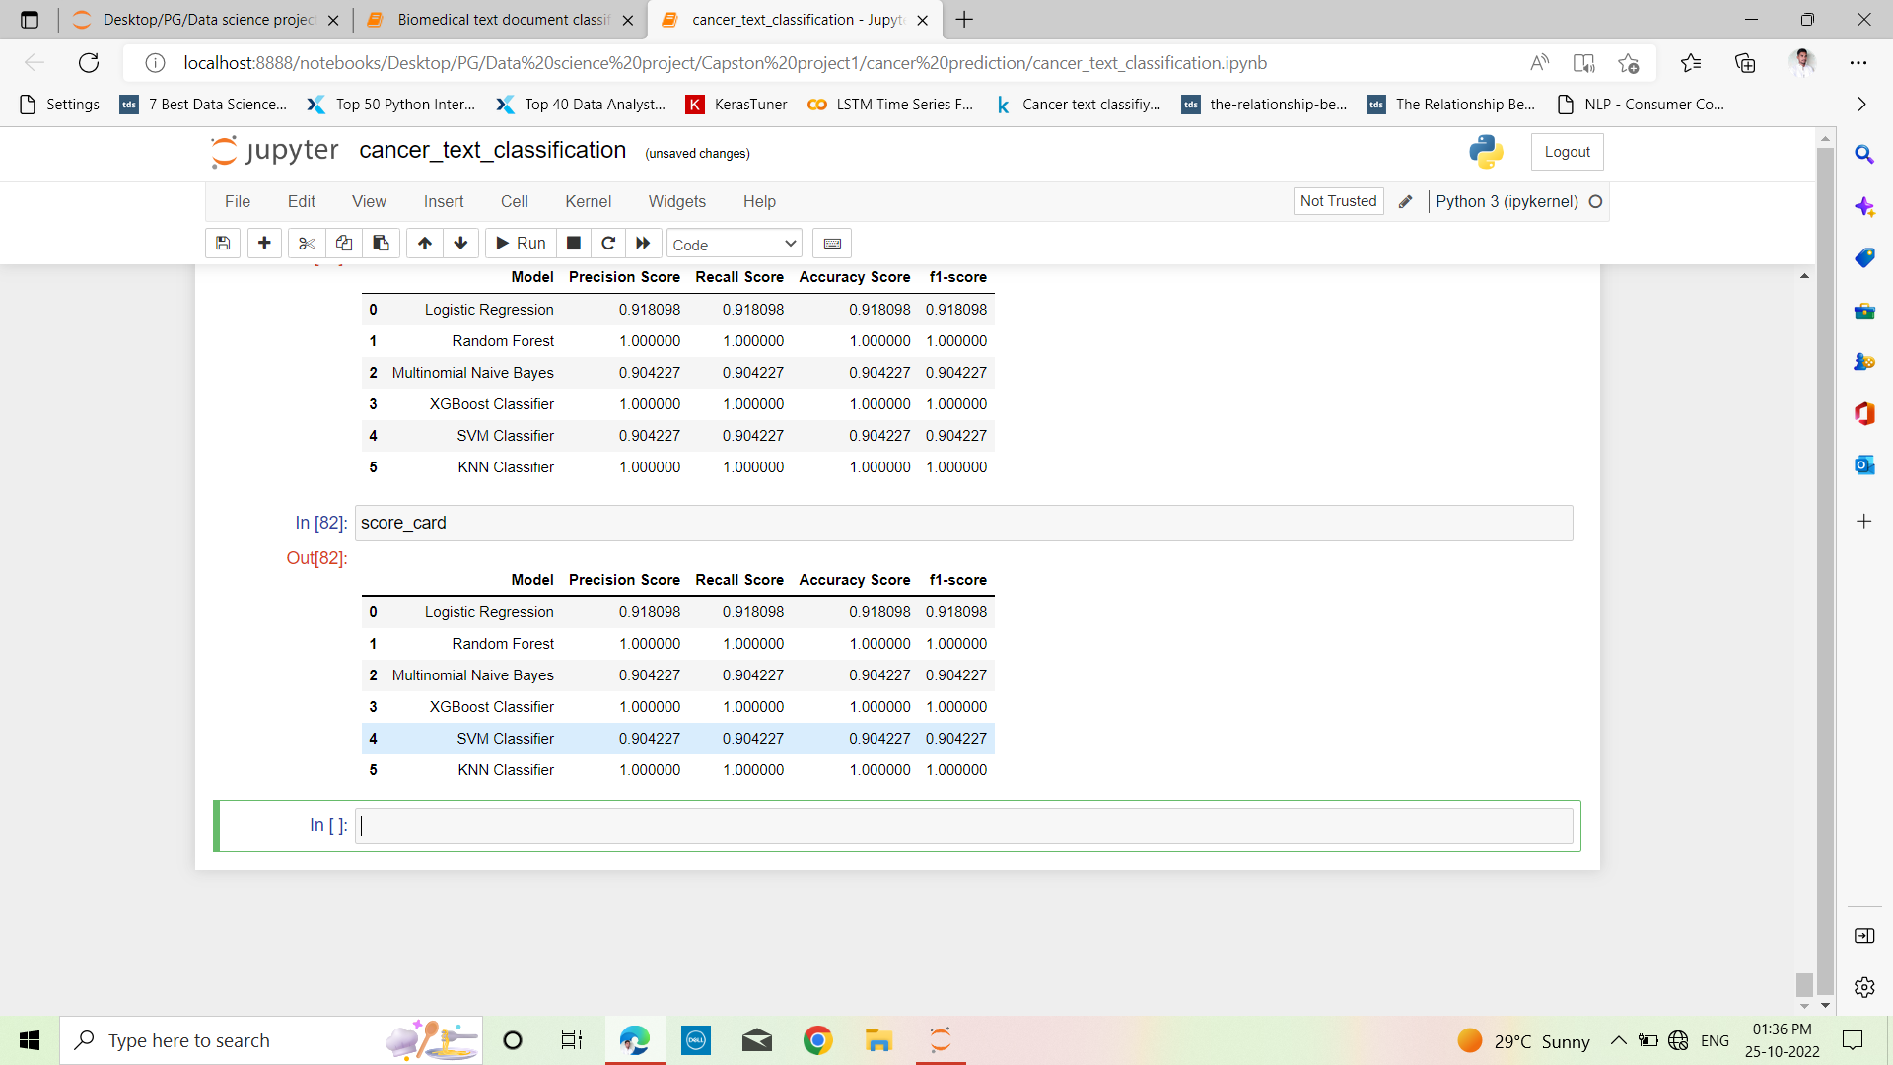
Model evaluation
The models are evaluated and considered matrix is accuracy.

Slide 35
conclusion
The Decision Tree Classifier, Random Forest Classifier and XGBoost classifier, KNN classifier gives the 100% accuracy of the model.
Working on this project is very knowledgeable .
This project can teach you a lot about text classification, and the main part of it is natural language processing.
As well as hands-on experience with various supervised machine learning algorithms.

Slide 36
Thanking you….

